Slide 1


Presented By:
P. Gayathri

Slide 2
Experience and linkedIn and GitHub URLs
I don't have traditional, full-time work experience, but I completed a three-month internship with Next Hub Technologies in the field of data science . During that internship, I worked on a project where I understanding of Data-Analytics in Dashboard and Machine Learning model . I was responsible for cleaning the data, performing exploratory analysis, and creating reports. It was a great opportunity for me to apply the skills I learned in my B.Tech to a real-world business problem
LinkedIn : www.linkedin.com/in/gayathri-polepalli-381506267
GitHub: https://github.com/Gayathri-7095

Slide 3
Introduction
The music industry produces vast amounts of data related to customers, artists, albums, and sales every day. Managing and analyzing this information is essential for improving performance and understanding customer preferences. Without a proper system, this data remains scattered and difficult to use effectively.
The Music Store Data Analysis aims to organize and store all music-related information in a single, well-structured relational SQL database. It connects key entities such as artists, albums, tracks, genres, employees, customers, and invoices, ensuring data consistency and easy retrieval.
Through this project, various SQL queries and analytical operations are used to generate insights like identifying top customers, best-selling artists, popular genres, and cities generating the highest revenue.
Overall, the project highlights how SQL-based database design and analysis can transform unorganized data into useful business insights for better decision-making and operational efficiency.

Slide 4
Problem Statement
In today’s digital music industry, managing large volumes of data about artists, albums, tracks, customers, and sales is a major challenge. The data is often scattered, making it difficult to analyze performance, customer behavior, and revenue trends. To address this issue, a Music Store Data Analysis is designed to store and manage all music-related data in a structured and centralized manner.
The project focuses on creating a relational SQL database that connects key entities like employees, customers, artists, albums, invoices, and playlists. It aims to simplify data retrieval and provide insights into business performance. Through SQL queries and analytical techniques, the project helps identify top customers, best-selling artists, popular genres, high-revenue cities, and senior employees.
This system enables efficient data management and supports data-driven decisions using advanced SQL features such as joins, aggregations, subqueries, and CTEs.

Slide 5


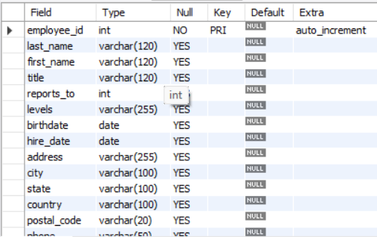
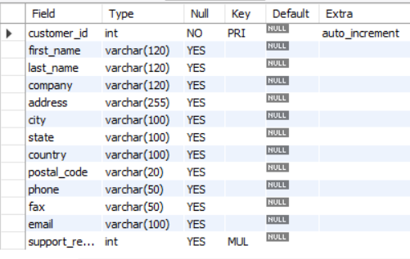
Tables
Genre table MediaType Table
Employee Table Customer Table

Slide 6


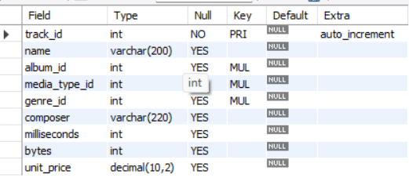
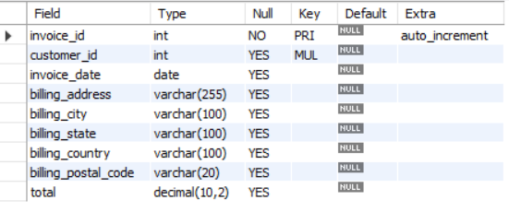
Tables
Artist Table Album Table
Track Table Invoice Table
Invoiceline Table

Slide 7
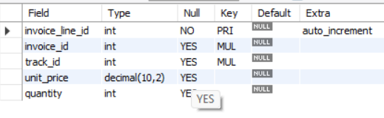


Tables
InvoiceLine Table Playlist Table
PlaylistTrack Table

Slide 8
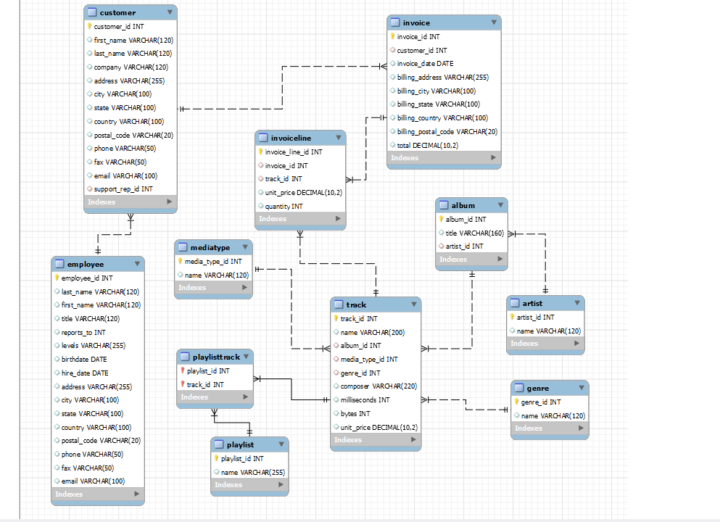
ER Diagram

Slide 9
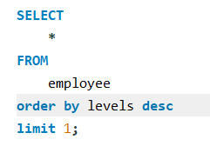
1. Who is the senior most employee based on job title?
- Madan mohan is the senior most, employee based on job title

Slide 10
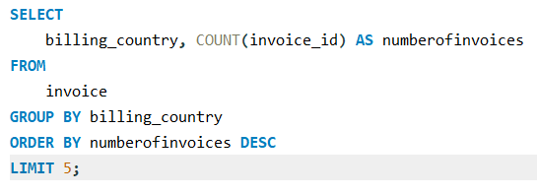
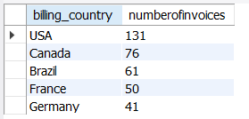
2. Which countries have the most Invoices?
- Usa , Canada , Brazil , France , Germany are the countries
have the most Invoices

Slide 11
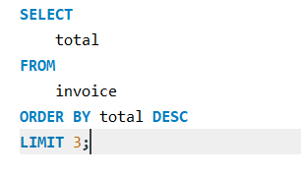
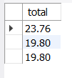
3. What are the top 3 values of total invoice?
- The top three values of the invoice totals are $23.76, $19.80, and $19.80.

Slide 12
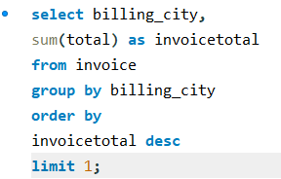

4. Which city has the best customers? - We would like to throw a promotional Music Festival in the city we made the most money. Write a query that returns one city that has the highest sum of invoice totals. Return both the city name & sum of all invoice totals
- Prague has the best customer.

Slide 13
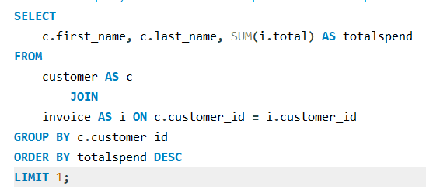

5. The customer who has spent the most money will be declared the best customer. Write a query that returns the person who has spent the most money.
The best customer, based on total spending, is František WichterlovAi , who has spent a total of $144.54.

Slide 14
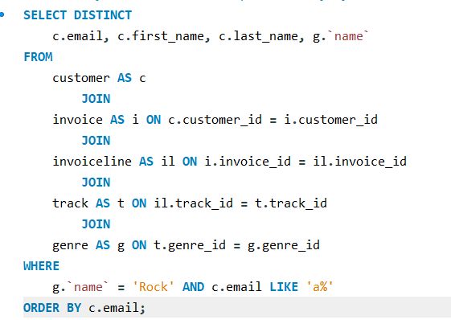
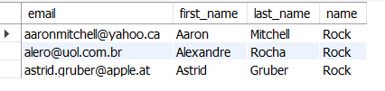
6. Write a query to return the email, first name, last name, & Genre of all Rock Music listeners. -- Return your list ordered alphabetically by email starting with A
- Aaron Mitchell, Alexandre Rocha, and Astrid Gruber are rock music listeners whose emails start with 'A'.

Slide 15
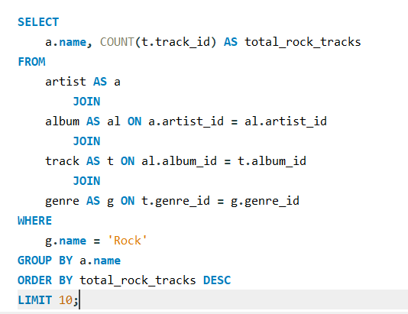
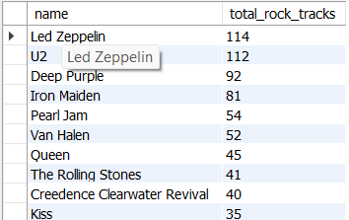
7. Let's invite the artists who have written the most rock music in our dataset.-- Write a query that returns the Artist name and total track count of the top 10 rock bands

Slide 16
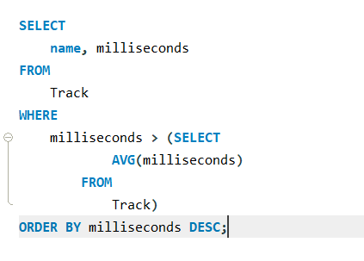
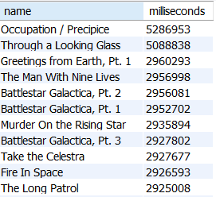
8. Return all the track names that have a song length longer than the average song length.-- Return the Name and Milliseconds for each track. Order by the song length, with the longest songs listed first

Slide 17
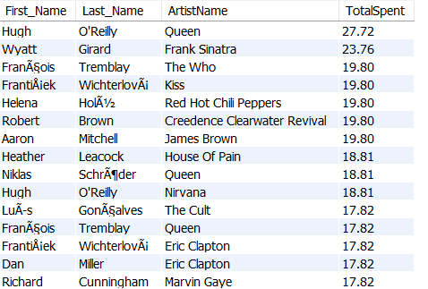
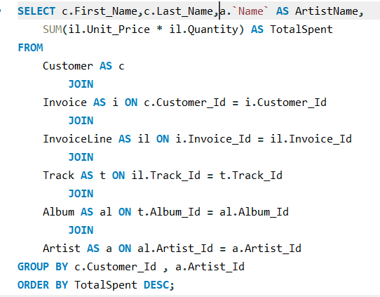
9. Find how much amount is spent by each customer on artists? Write a query to return customer name, artist name and total spent

Slide 18
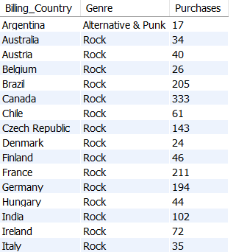
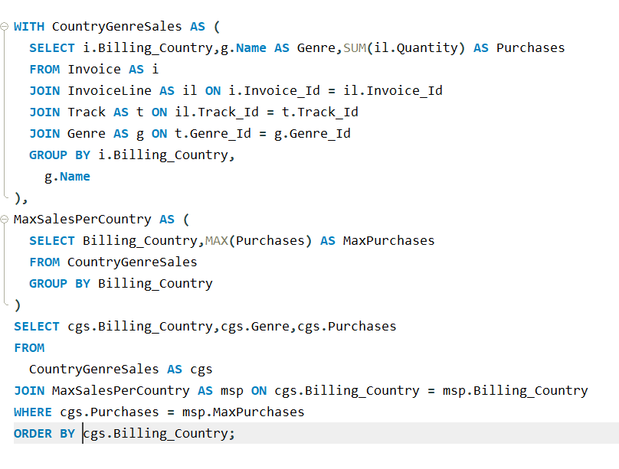
10. We want to find out the most popular music Genre for each country. -- We determine the most popular genre as the genre with the highest amount of purchases. -- Write a query that returns each country along with the top Genre. -- For countries where the maximum number of purchases is shared, return all Genres

Slide 19
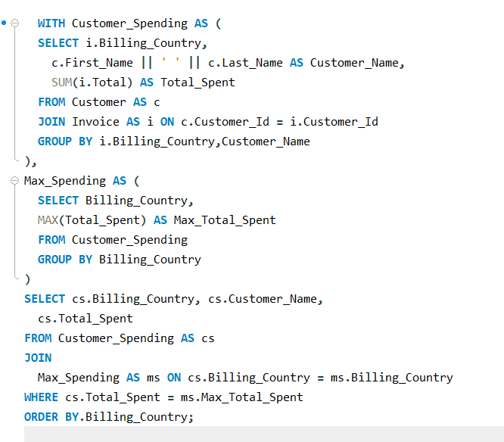
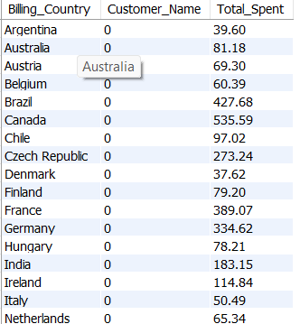
11. Write a query that determines the customer that has spent the most on music for each country. -- Write a query that returns the country along with the top customer and how much they spent. -- For countries where the top amount spent is shared, provide all customers who spent this amount

Slide 20
conclusion
The data conclusively shows that the music store's success is driven by a highly concentrated,
yet valuable, market. The clear path for growth is to leverage the dominance of the
Rock genre and actively engage with top-performing customers and cities to maximize
revenue.

Slide 21


